Slide 1

HR Analytics Dashboard — Employee Attendance Analysis
Project overview: An interactive Excel dashboard built to monitor workforce presence, Work From Home (WFH) behaviour and sick leave (SL) trends to evaluate attendance stability, surface pattern-based absenteeism, and deliver data-driven recommendations to support workforce productivity and planning.
Arya Chavan

Slide 2



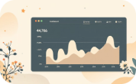

Project Objectives
Analyse attendance performance
Monitor WFH & SL trends
Identify weekday patterns
Track daily attendance fluctuations
Track remote-working adoption and medical absenteeism to inform policy.
Quantify present rates and detect persistent gaps across teams and time.
Detect repeating weekday dips or spikes that could signal behavioural patterns.
Surface dates where attendance <85% and flag for investigation.
Recommend optimisation actions
Offer targeted interventions to improve coverage, engagement and planning.
Arya Chavan

Slide 3
Key Metrics — At a glance
Overall Attendance Rate
Total Working Days
Total Present Days
WFH %
4,064
11.15%
91.55%
4,439
Sick Leave (SL %)
1.08%
These KPIs form the executive summary for operational monitoring and strategic planning. Use them as control metrics when testing policy changes or staffing models.
Arya Chavan

Slide 4

Key Insight — Attendance Stability
Attendance is strong at approximately 91.5%, with SL near 1%, indicating low health-related absenteeism. Present days represent the large majority of working days, demonstrating consistent workforce availability.
Operational meaning
Risk
Core staffing levels are reliable; scheduling and shift coverage can assume high baseline presence.
Periodic dips may cause localised service gaps if not addressed proactively.
Arya Chavan

Slide 5

WFH Patterns
WFH accounts for 11.15% of attendance. The highest concentration occurs on Fridays and Mondays, suggesting extended-weekend behaviour or flexible scheduling preferences.
Implication
Action
Teams may experience lower synchronous availability at week edges; plan meetings midweek.
Consider targeted guidelines for expected on-site or core-hours coverage around long weekends.
Arya Chavan

Slide 6
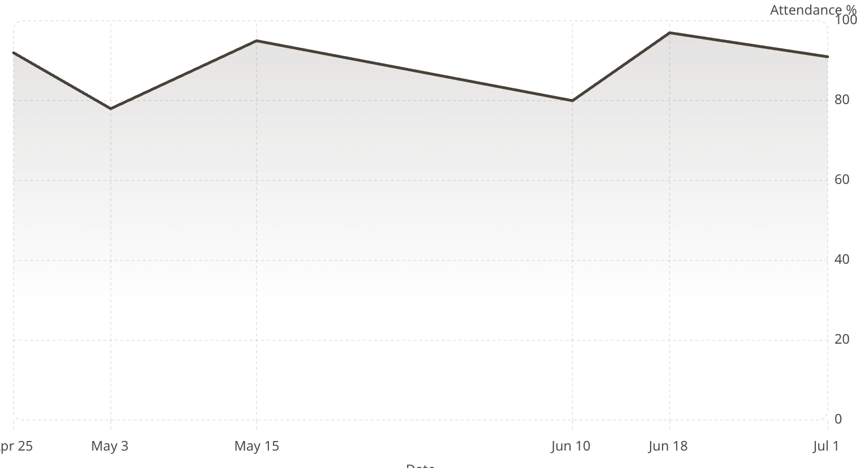
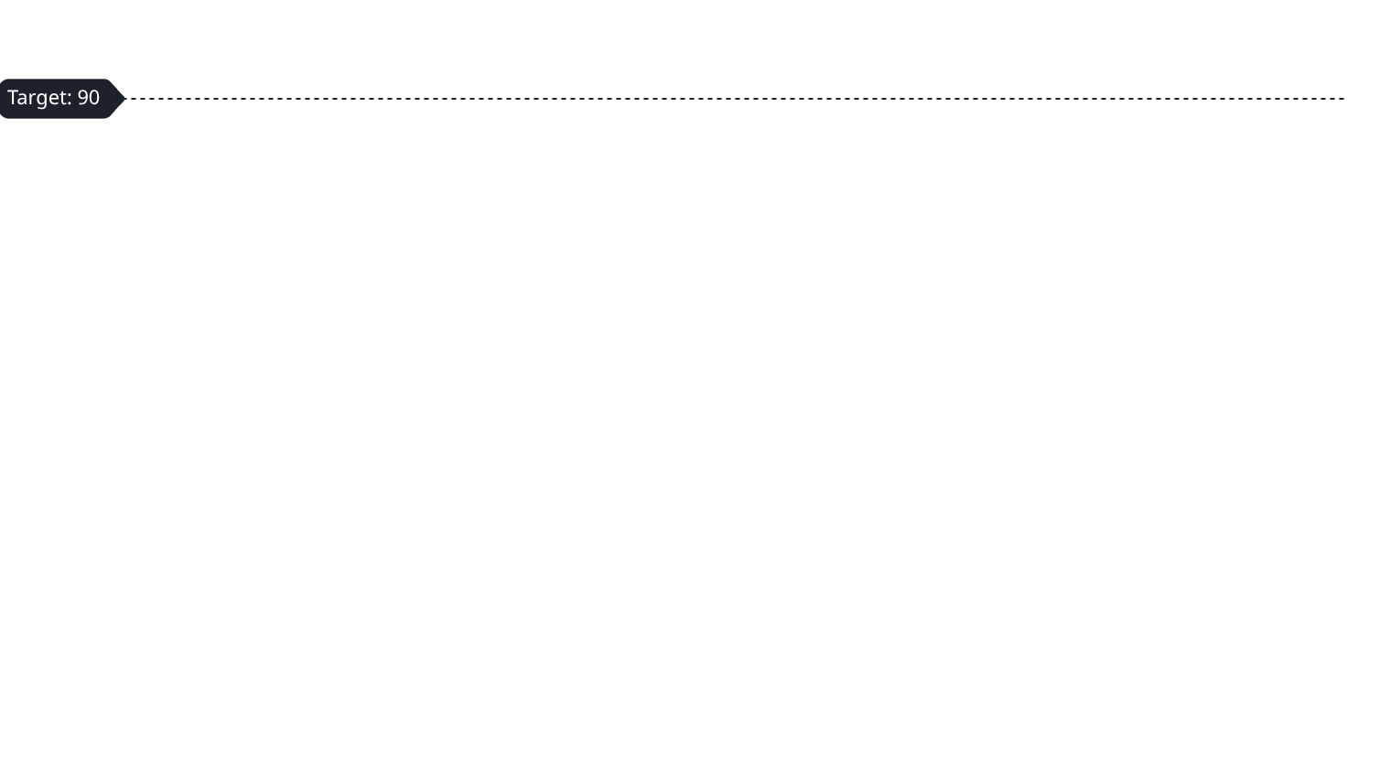
Daily Attendance Trends
Attendance typically ranges from 78–97%. Most days exceed 90%, but notable dips in early May and mid-June warrant root-cause analysis (events, weather, policy changes, local outbreaks).
Arya Chavan

Slide 7

Monday
Friday
Higher WFH; stagger meetings
Elevated WFH; flexible hours
Weekday Analysis
Friday and Monday show elevated WFH rates relative to midweek. Tuesday–Thursday demonstrate consistent on-site presence and stable collaboration windows.
Tue–Thu
Action
Stable on-site presence
Schedule cross-team midweek
01
02
Adjust scheduling
Monitor policies
Schedule cross-team meetings midweek to maximise participation.
Track whether flexible policies cause productivity variance on high-WFH days.
Arya Chavan

Slide 8
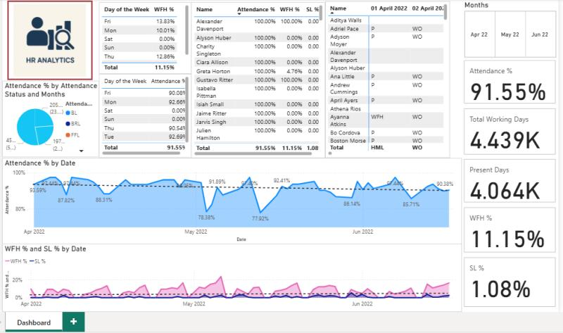
Dashboard Preview
A representative screenshot of the Excel workbook (KPI header, trend charts, weekday heatmap and employee table). This visual demonstrates layout, interactivity and the primary analytic views stakeholders will use.
Visuals emphasise clarity: KPIs at the top, interactive trend charts middle, and detailed tables below for drill-down analysis.
Arya Chavan

Slide 9


Recommendations & Next Steps
Monitor and investigate WFH spikes on Fridays and Mondays — tie to team-level outcomes.
Flag dates where attendance falls below 85% for targeted root-cause analysis.
Align remote-work policy with productivity metrics and set core collaboration hours midweek.
Implement sample-based performance tracking during WFH days to validate outcomes.
Establish quarterly attendance reviews using the dashboard and A/B test policy changes.
Priority next step: To run a two-month pilot requiring core hours Tuesday–Thursday for cross-functional teams, measure meeting attendance and task completion to evaluate impact.

